Slide 1


Batch - 1: HUMAN EMOTION DETECTION
01
2023
Presented by
Kota Harsha – 22R21A6695
CH. Rakesh – 22R21A6678
B. Vishnu – 22R21A6674
B. Rohit - 22R21A6673

Slide 2
Table of contents
01
02
03
Problem Statement
Customer Survey
Solution and Design
02

Slide 3

Problem Statement
The problem statement of human emotion detection is to generate algorithms or models that can detect and identify the emotion of a person based on various inputs such as facial expressions, tone of voice and body language.
Emotion detection has various potential applications, including in healthcare, education, marketing, and social robotics, among others.
The challenge lies in developing resilient and reliable algorithms that can accurately discover emotions despite individual differences and cultural variations, and in addressing ethical and privacy concerns associated with the use of this mechanism.
03

Slide 4

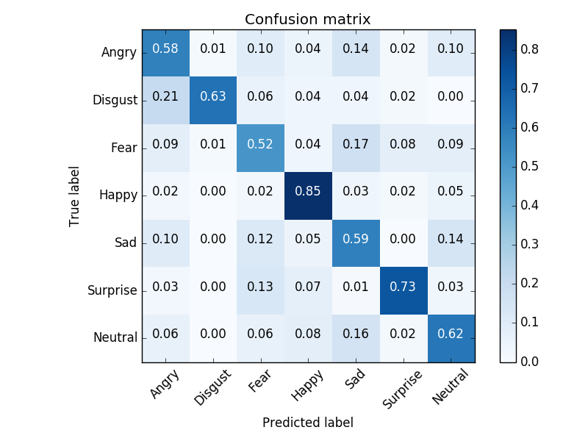
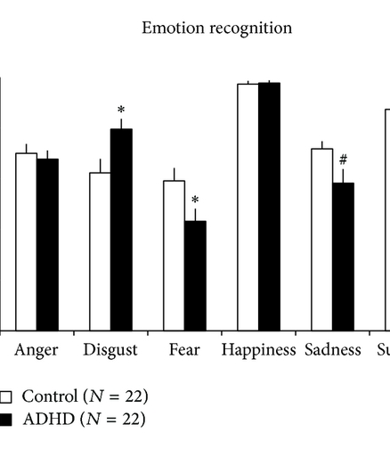
Customer Survey
04

Slide 5
Problem and solution
05
Problem
Solution
Technical challenges:
Data augmentation
Face occlusion and lighting issues
Identifying facial features
Recognizing incomplete emotions
Capturing the context of emotion
Racial differences
Psychological challenges:
Cultural differences in emotional expression
Incorrect emotion indicators
Create your own dataset.
Combine several datasets.
Modify the data as you go

Slide 6
Exisisting Solutions
06
Solution 1
Solution 2
Microsoft Azure provides a Face API for processing real-time and prerecorded images and videos.
Amazon Rekognition is an AWS emotion recognition API. It analyzes real-time and prerecorded images and videos. This API detects objects and activities, recognizes handwritten text, counts people and objects in the frame, and monitors for unsafe content.

Slide 7

Product Overview
07
The project utilizes machine learning algorithms to analyze and interpret facial expressions in real-time.
The product is designed to recognize a range of emotions, including happiness, sadness, anger, surprise, fear, and disgust.
The technology is capable of detecting emotions from both images and video footage.
The facial emotion recognition system can be integrated into various applications, such as video conferencing software, customer service chatbots, and marketing research tools.
The product can also be used in various industries, including healthcare, education, entertainment, and security.
The facial emotion recognition technology can be customized to suit the specific needs of a business or organization.
The system can provide detailed insights into the emotional state of individuals, allowing for more personalized interactions and improved communication.

Slide 8
SWOT Analysis
08
Opportunities
Strengths
Weakness
Threats

Slide 9
Strengths | Weakness
Human emotion detection can help improve mental health and wellbeing by detecting and addressing negative emotions and stress. Emotion detection can be used in a variety of settings, such as healthcare, education, and workplace environments, to help improve communication and relationships. Emotion detection technology is constantly improving, with the development of more accurate and sophisticated tools for detecting emotions. | Emotion detection is not always accurate and can be influenced by a variety of factors, such as cultural differences and individual expressions of emotions. The use of emotion detection technology can raise ethical concerns, such as invasion of privacy and potential misuse of data. There is a risk of overreliance on technology for emotion detection, which can lead to a lack of empathy and understanding in human interactions.
Opportunities | Threats
Emotion detection technology can be used to help diagnose and treat mental health conditions, such as depression and anxiety. Emotion detection can help improve communication and relationships in various settings, such as customer service, healthcare and education. Emotion detection can be integrated into various products, such as wearable devices and smartphones, to provide real-time feedback and support for emotional wellbeing. | The use of emotion detection technology can lead to discrimination and bias, especially if the technology is not properly calibrated or trained. There is a risk of privacy violations if emotion detection technology is used without consent or appropriate safeguards in place. There may be resistance or reluctance to adopt emotion detection technology, particularly if people feel uncomfortable with the idea of their emotions being monitored or analyzed.
09

Slide 10
10
Value proposition (Product)
Gain creators
Develop a facial emotion detection software
Offer facial emotion detection services
Sell facial emotion detection hardware
Products and services
Real-time emotion detection
Multi-platform support
Security
Integration
Analytics and reporting
Customer support
Pain relievers
Our product offers facial emotion recognition according to user requests.

Slide 11
11
Value proposition (Customers)
Gains
Customers can easily explore different facial emotion recognition in daily life apps,etc
Customer jobs
Personalized customer service
Marketing and advertising
Employee training
Pains
Improving mental health
Improving education
Improving security

Slide 12
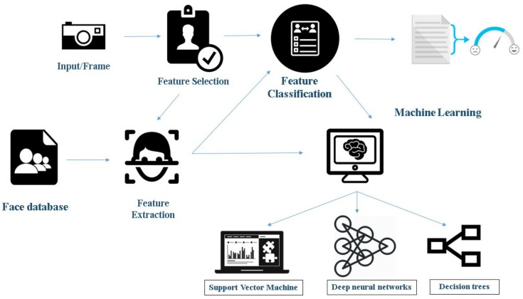
Design Blueprint

Slide 13
Thank You!
13
Do you have any questions?

